Slide 1
Lecture-22
SHORT-TIME FOURIER TRANSFORM(STFT)
STFT → (a) Analysis (b) synthesis
Analysis:- FT view and Filtering view
Synthesis:-Filter bank summation (FBS) Method and OLA Method

Slide 2
Short-Time Fourier Analysis(STFT)
Represent signal by sum of sinusoids or complex exponentials which leads to convenient solutions to problems like formant estimation, pitch period estimation, analysis-by-synthesis methods)

Slide 3
Short-Time Fourier Transform
Speech is not a stationary signal, i.e., it has properties that change with time.
Thus a single representation based on all the samples of a speech utterance, for the most part, has no meaning
Define a time-dependent Fourier transform (TDFT or STFT) of speech that changes periodically as the speech properties change over time

Slide 4
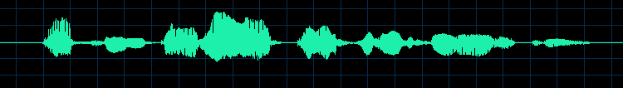
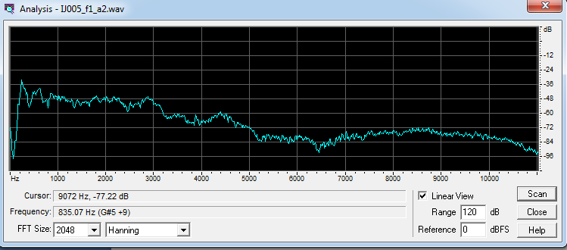
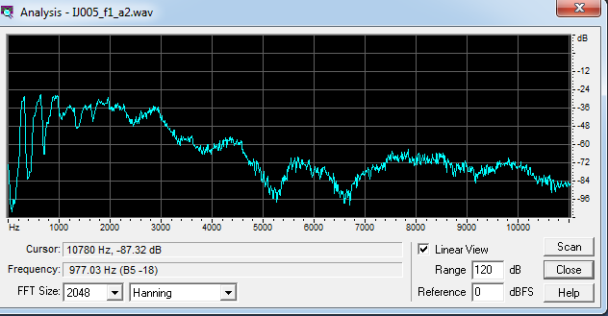

Slide 5
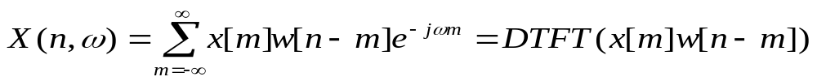
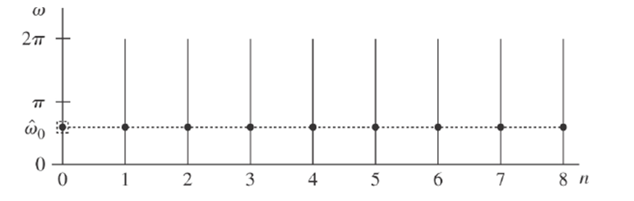
STFT is a function of two variables, the time index, n which discrete and the frequency variable ω which is continuous

Slide 6
Different time origins of STFT
STFT can be viewed as having two different time origins
1. Time origin tied to signal
2. Time origin tied to window

Slide 7
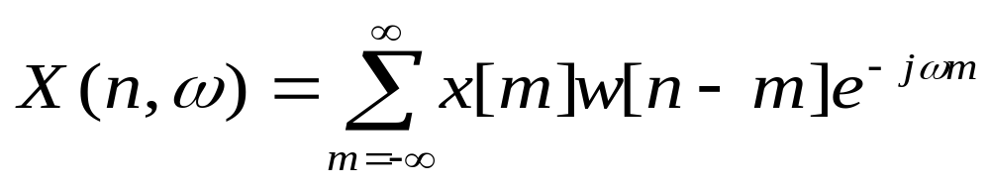
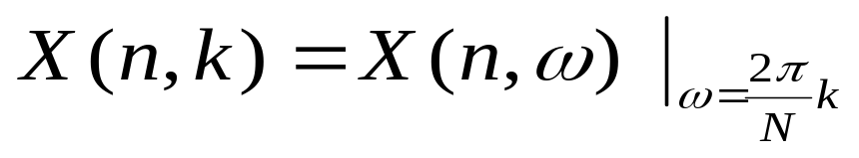
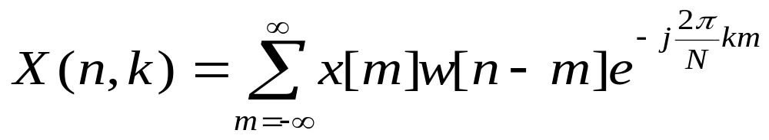
STFT Analysis
DFT view
w[n] is non zero only in the interval [0,N-1] where N is the window length
Time reversing the analysis window w[m] and multiplying it with x[m]
DFT
STFT

Slide 8
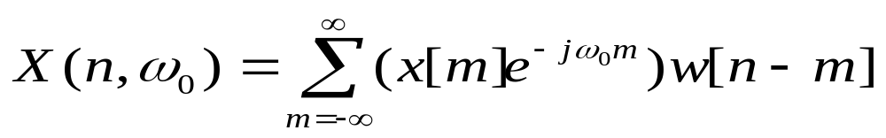
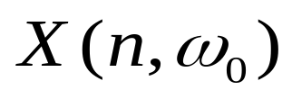
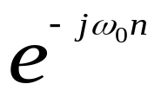

Filtering view
The signal x[n] is first modulated with e^{−jω0n}, and then passed through a filter with impulsive response w[n].
x[n]
w[n]
X

Slide 9
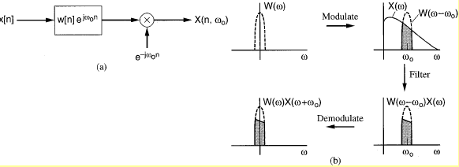
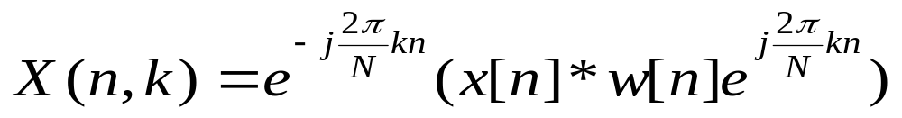
That is, the sequence x[n] is first passed through the filter w[n] with a linear phase factor. The output is then modulated by e^{− jω0n} .

Slide 10
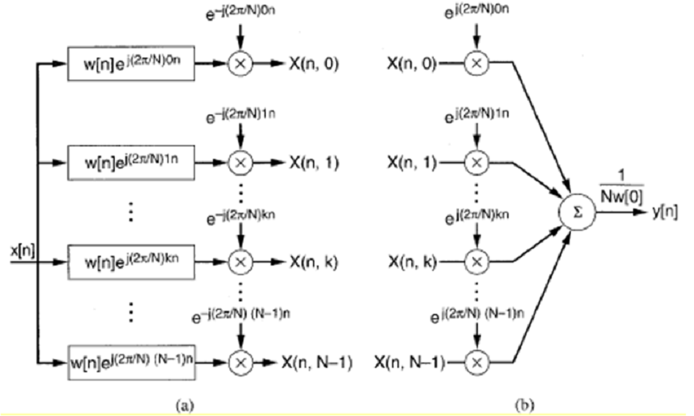
Analysis with the discrete STFT

Slide 11
General properties of the filtered sequence
If x[n] has length N and w[n] has length M then X(n,ω) has length N+M-1
The bandwidth of the sequence X(n,ω₀) is less than or equal to the bandwidth of w[n]
The sequence X(n,ω₀) has the spectrum centered at origin

Slide 12
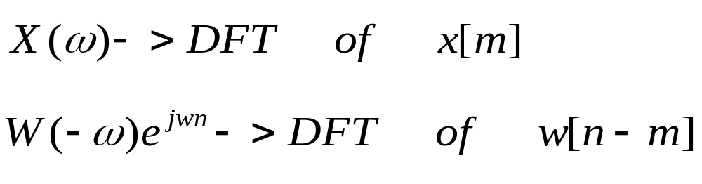
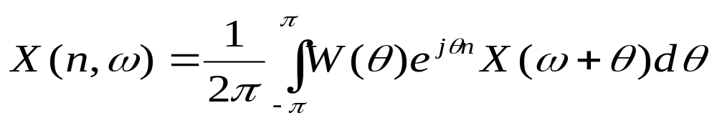
Time-Frequency Resolution Tradeoffs
A fundamental problem of STFT and other time-frequency analysis techniques is the selection of the windows to achieve a good tradeoff between time and frequency resolution.

Slide 13
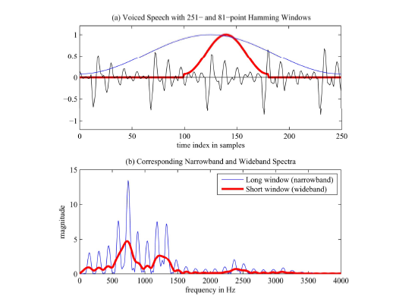
Role of Window in STFT
The window w(n−m) does the following:
  Chooses portion of the signal to be analyzed
  Window shape determines the nature of the X(n, ω )

Slide 14
STFT Synthesis
For a given value of n, X(n,ω ) has the same properties as a normal Fourier transform, we can recover the input sequence exactly.
For each n , we take the inverse Fourier transform of X(n,ω) from the STFT.
Then obtain f[m]=x[m]w[n-m] .
Evaluating f[m] at m = n, obtain x[n]w[0] . Assuming w[0] ≠ 0
Then x[n]= f[n] /w[0]

Slide 15
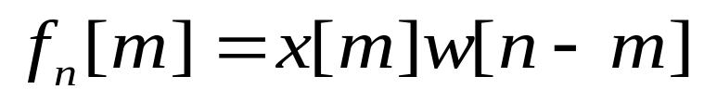

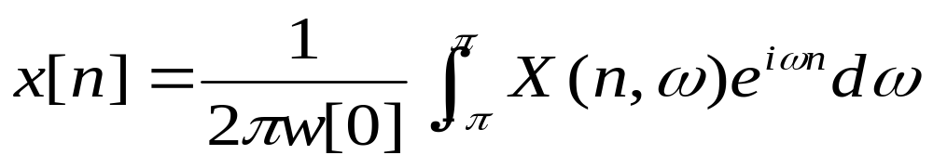
DFT
If the STFT is unique representation of x[n] then it invertible.
IDFT at m=n
Synthesis equation for discrete-time STFT

Slide 16
With the requirement that w[0]≠0 , the sequence x[n] can be recovered exactly from X(n, ω), if X(n, ω) is known for all values of ω over one complete period
  Sample-by-sample recovery process
  X(n, ω), must be known for every value of n and for all ω
To reduce the computational complexity, the STFT is not computed at every time sample, but rather at a certain time decimation rate. In some cases, the discrete STFT may not be invertible, i.e. there are certain constraints on the frequency-sampling and time-decimation rates.

Slide 17
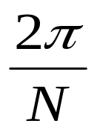
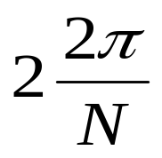
By selecting appropriate constraints on the frequency sampling and time decimation rates the discrete STFT is invertible
Lost Spectral Region
B
B is the band with of w[n]
Analysis window slide one sample at a time
It also invertible is temporal decimation factor L is equal to or less then the size of the analysis window and the frequency sampling interval 2π/N≤ 2π/N_{w}

Slide 18
Lecture-23
Filter Bank Summation (FBS) method

Slide 19
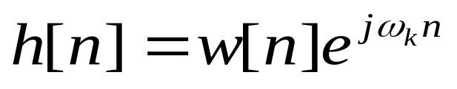
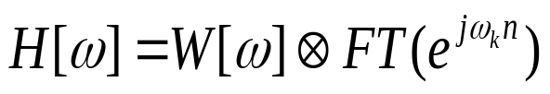

The filter bank interpretation of the STFT shows that for any frequency ω_{k}, X(n, ω_{k} ) is a low-pass representation of the signal in a band centered at ω_{k}
w[n]
W(ω)
-ω_{p}
ω_{p}

Slide 20

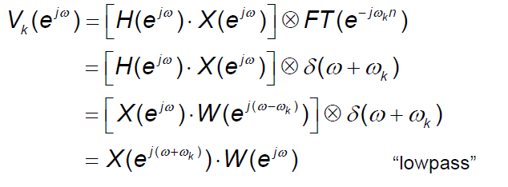
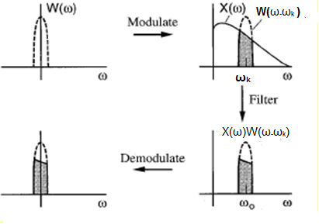

Slide 21
Reconstructing x[n] from the STFT
X(n, ω_{k}), is known for all N frequencies
N band pass filters with impulse responses
W[n] is an ideal low pass filter with cut-off frequency ω_{p}

Slide 22
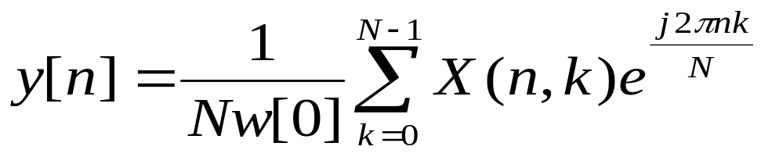
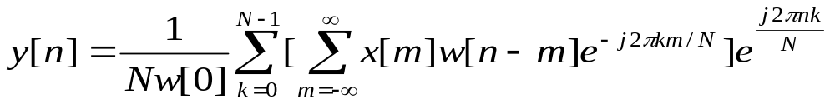
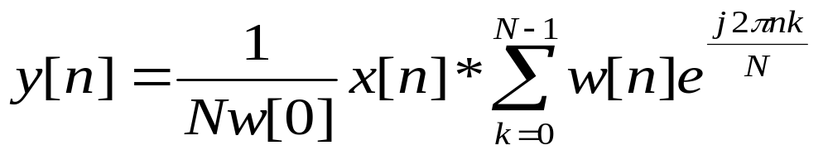
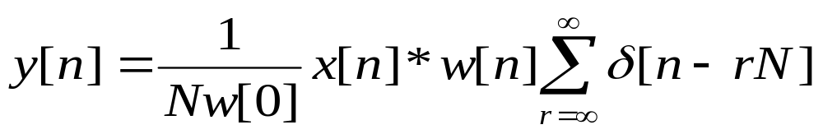
Filter Bank Summation (FBS) method
Since
Finite sum over the complex exponential reduce to an impulse train with period N

Slide 23
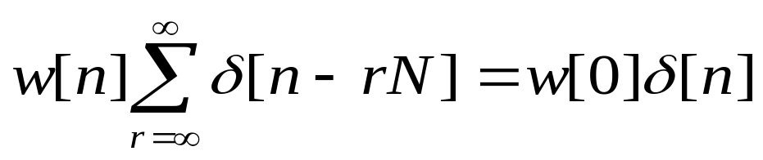

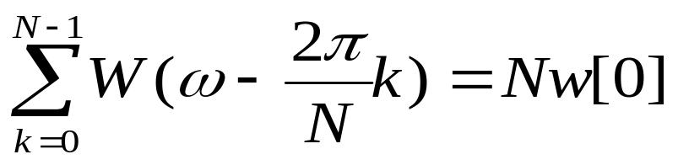

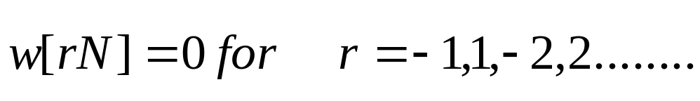
if
then
Let N_{w} is the window length
N_{w} should be less than or equal to the number of analysis filter N
Shifted version of the Fourier transform of the analysis window were required to add up to a constant
N_{w}>N provided the following

Slide 24
Analysis with the discrete STFT

Slide 25
Summary of FBS Method
Perfect reconstruction of x[n] from X(n, ω ) is possible using FBS under following conditions
  1. w(n) is a finite duration window
  2. X(n, ω ) is sampled properly in both time and frequency
To avoid time aliasing, X(n, ω ) must be evaluated at least L uniformly spaced frequencies, where L is the window length
Exact reconstruction of the input is possible with a number of frequency channels less than that required by the sampling theorem
There is a way (at least theoretically) for X(n, ω ) to be evaluated in non-overlapping bands and for which x(n) can still be exactly recovered

Slide 26
Lecture-23
Overlap-Add (OLA) method

Slide 27
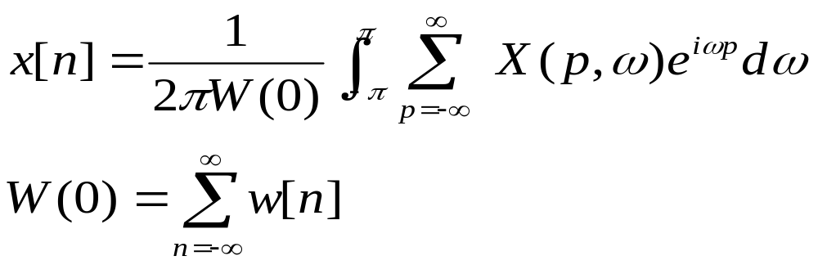
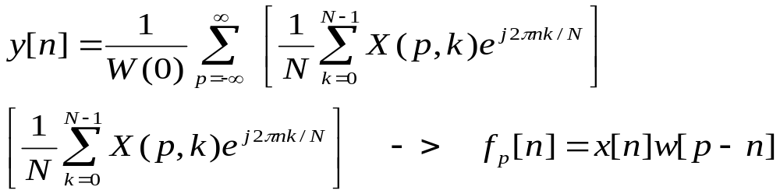
Overlap-Add (OLA) method
Take inverse DFT for each fixed time in the discrete STFT. Instead of dividing out the analysis window from each of the resulting short time sections perform an overlap add operation between the short sections
Overlap and add operation effectively eliminates the analysis window

Slide 28
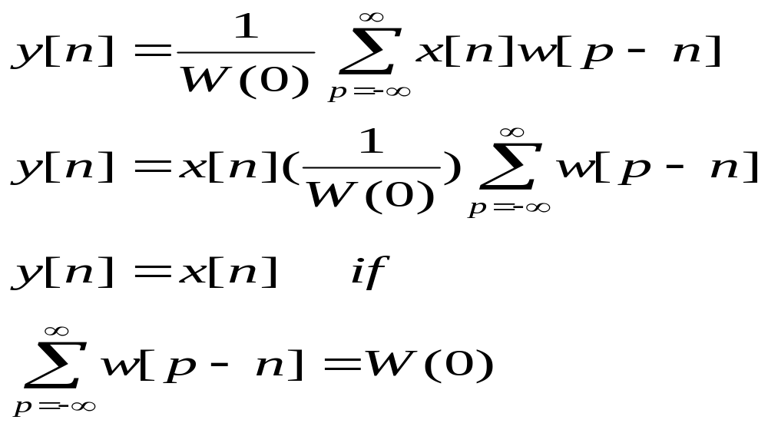
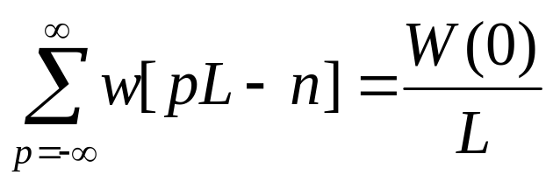
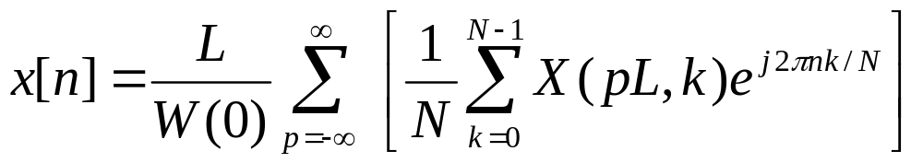
Sum of values of a sequence must be the first value of its Fourier Transform
Sum of all the analysis windows to a constant

Slide 29

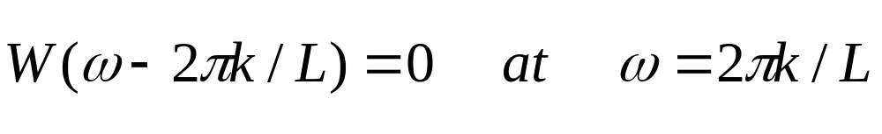
This finite bandwidth can be relaxed provided

Slide 30
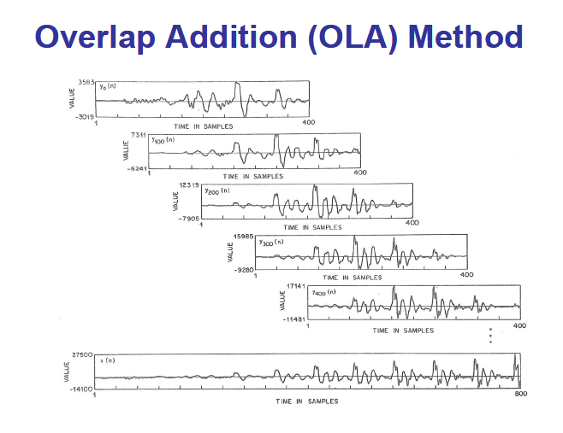

Slide 31
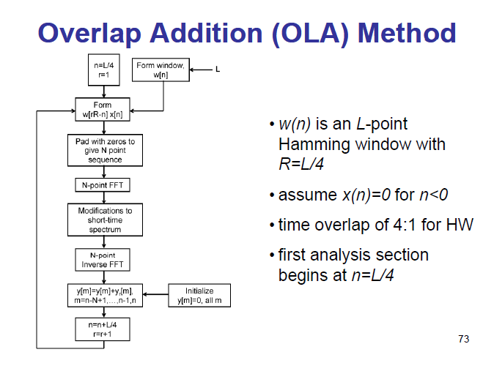

Slide 32
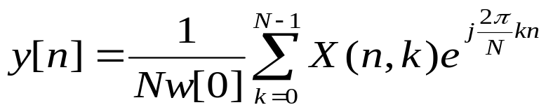
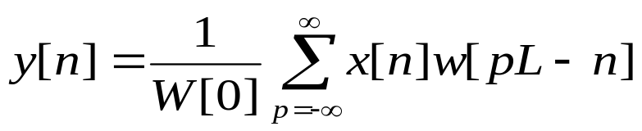
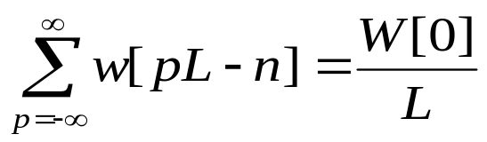

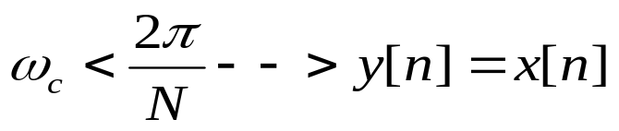

FBS and OLA Comparisons
FBS Method
OLA Method
Adding time component for each n
Adding Frequency component for each n
Constraint
Constraint
Sampling relation in frequency
Sampling relation in time

Slide 33
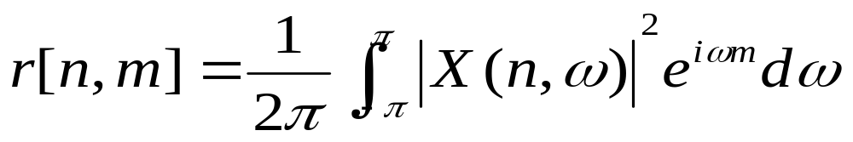
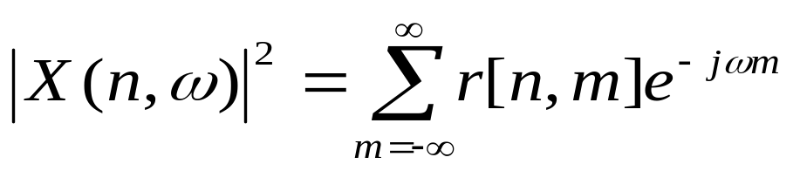
Short-Time Fourier Transform Magnitude
The squared STFT magnitude is called the spectrogram or short time Fourier transform magnitude (STFTM).
Although the phase information is removed in STFT, many signals can still be uniquely synthesized from STFTM.
The relation between STFTM and the short-time autocorrelation r[n,m] is:
where m is the autocorrelation “lag”, r[n,m]=f[m]*f[-m]
f[m]=x[m]w[n-m]

Slide 34
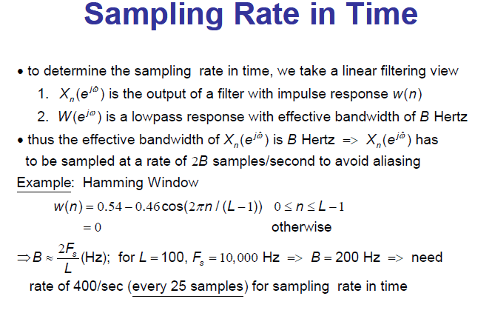

Slide 35
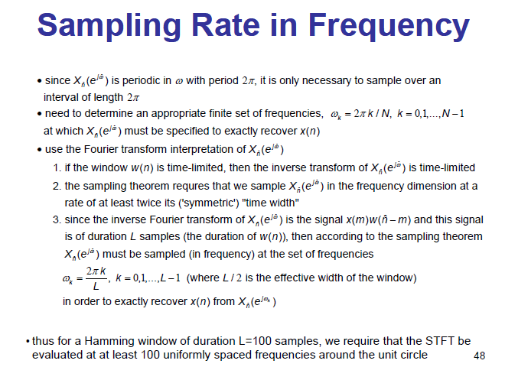

Slide 36
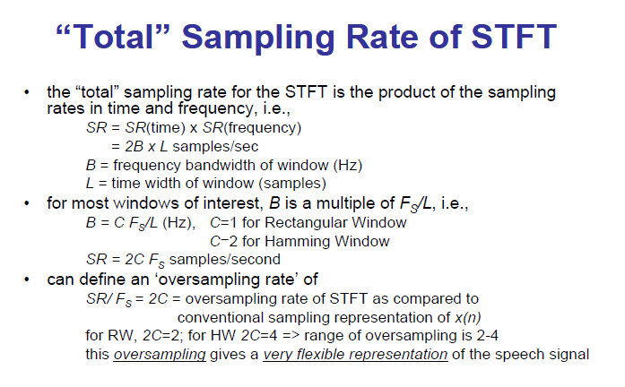

Slide 37
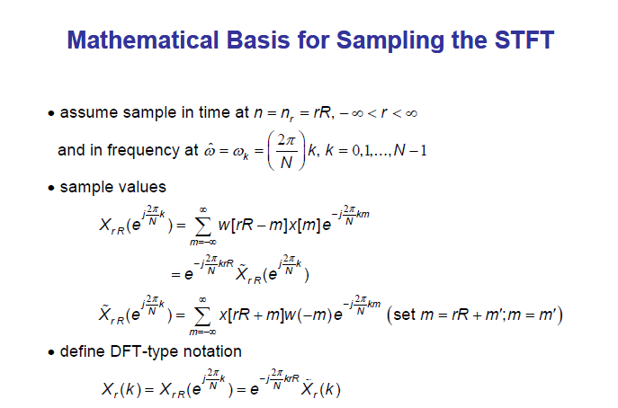

Slide 38


Slide 39


Slide 40
The key to Short-Time Fourier Analysis is the ability to modify the short-time spectrum (via quantization, noise enhancement, signal enhancement, speed-up/slow- down, etc) and recover an "unaliased" modified signal

Slide 41
Application of STFT Analysis and Synthesis
Signal Estimation from Modified STFT or STFTM
Time Scale Modification and Enhancement of Speech
Noise Reduction

Slide 42
Goal
  To either speed up or slow down a speech signal while maintaining the approximate pitch
Applications
  Change voice mail playback
  Court stenographers-play proceedings quicker
  Sound effects
  Etc…

Slide 43
Option 1 – Change sample rate
  If you modify the sample rate, you can change the speed but the pitch is also changed
    Increase sample rate = higher pitch (chipmunk sound)
    Decrease sample rate = lower pitch (drawn out echo sound)
Option 2 – Decimate or Interpolate Signal
  If you change the number of samples, the result is the same as modifying the sample rate

Slide 44
Option 3 – Use more complex methods
  This will change the speed of the sample while preserving the pitch data
    Short Time Fourier Transform
    Short Time Fourier Transform Magnitude
    Sinusoidal Synthesis
    Linear Prediction Synthesis
Slide <number> of 49

Slide 45

Frame Rate
Window Size
Slide <number> of 49

Slide 46
Short Time Fourier Transform
Frame Rate factor L
  In frequency domain after taking the STFT, you get
    X(nL,ω)
  Form a new signal by
    Y(nL, ω) = X(snL, ω)
      where s = compression factor
Take Inverse Fourier Transform
Use Overlap and Add method to form new signal
Slide <number> of 49

Slide 47

Short Time Fourier Transform
X(nL, ω)
Y(nL, ω)
= X(2nL, ω)
Slide <number> of 49

Slide 48
Short Time Fourier Transform
Short Time Fourier Transform
  Also called the Fairbanks method
  Extract successive short-time segments and then discard the following ones
Signal
STFT
Decimate
Samples
IFFT
OLA
Output
Slide <number> of 49

Slide 49

Problems
  Pitch Synchronization
    It is highly likely that the pitch periods will not line up properly
Slide <number> of 49

Slide 50
Short Time Fourier Transform Magnitude
  Problems with STFT method relate directly to the linear phase component of the STFT
    Time shift = phase change
  Alternate approach is to only use the magnitude portion of the STFT—Short Time Fourier Transform Magnitude
Slide <number> of 49

Slide 51
Short Time Fourier Transform Magnitude
Compression
  With the Fairbanks method, time slices were discarded
  Now we can just compress the time slices
  Form a new signal by
    |Y(nM, ω)| = |X(nL, ω)| where
      M = compression factor = L / speed
      i.e. for speeding up by two => M = L/2
  Take Inverse Fourier Transform
  Use Overlap and Add method to form new signal
Slide <number> of 49

Slide 52

Short Time Fourier Transform
Magnitude
X(nL, ω)
Y(nM, ω)
= X(nL, ω)
M=L/2
Slide <number> of 49

Slide 53
END

